Slide 1

Cluster district in Bangkok

Slide 2

Cluster district in Bangkok
Bangkok have a lot of venues i.e. megamalls, modern spaces, golden temples and shrines, and floating markets.
However, Bangkok is also very high-density population and very high traffic jams.
If, I want to buy a new house or condo in Bangkok, it is advantageous for me to cluster each district in Bangkok for decision what location is best to buy.

Slide 3
Data acquisition and cleaning
Scraping common districts in Bangkok data from Wikipedia
Statistics data about area in each district in Bangkok and calculate density population
Forsquare API for get the venues of each district in Bangkok
There are not too many public data related to demographic and social parameters. In many case, I setup my on table.

Slide 4
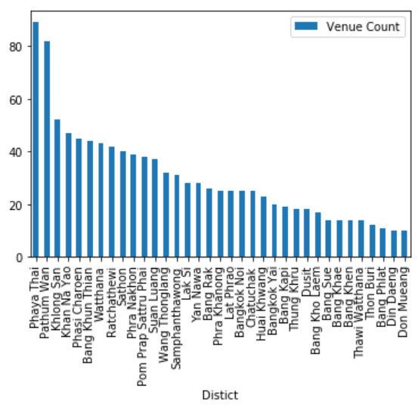
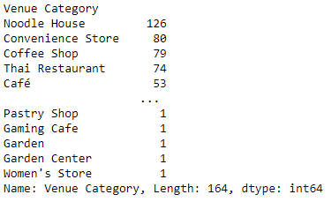
Number of venue category in each district

Slide 5
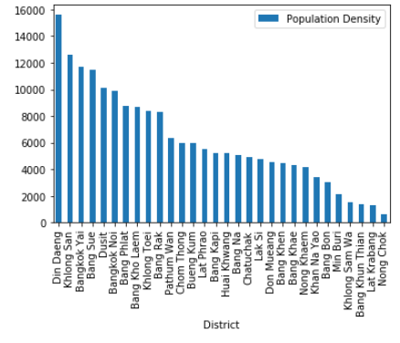
Population density in each district

Slide 6
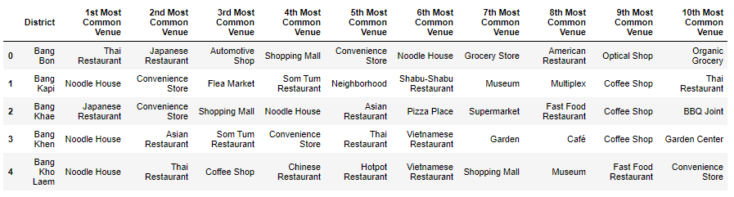
Sample of top 10 venues in each district

Slide 7
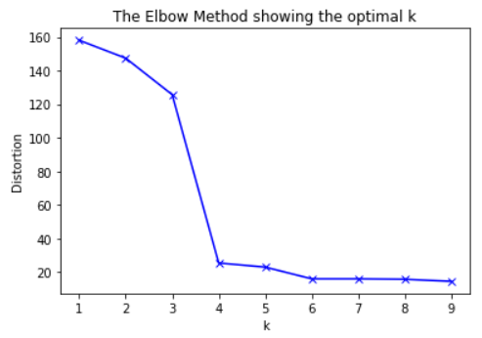
Elbow of K-Mean predict algorithm

Slide 8
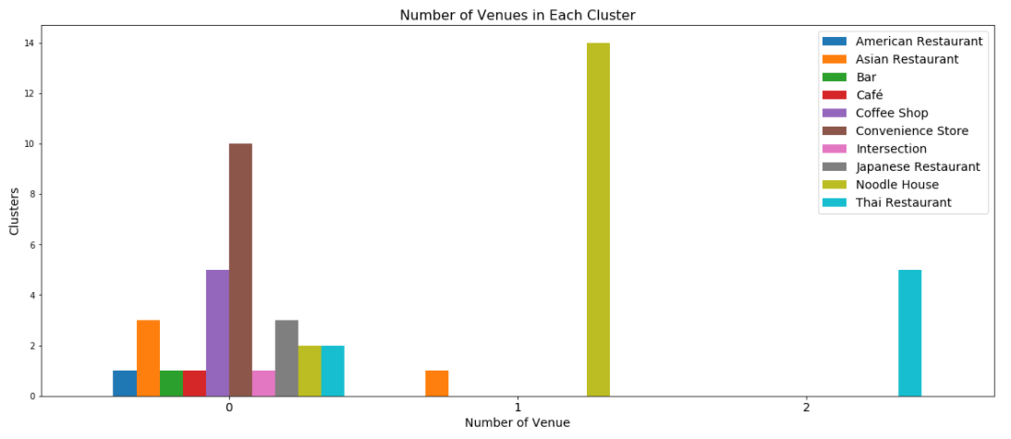
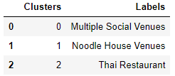
Number of venues in each cluster

Slide 9
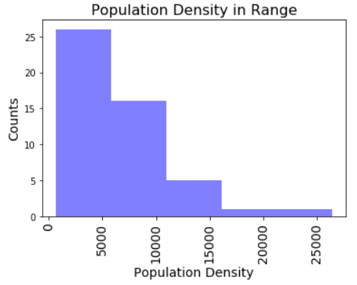
Population density in range

Slide 10
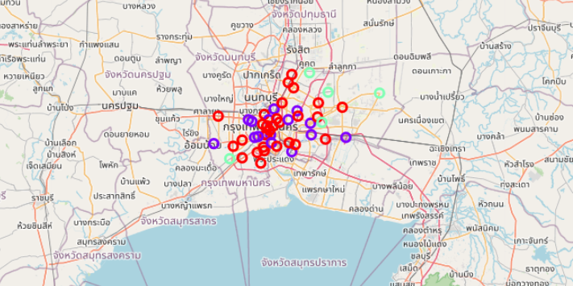
Map with results

Slide 11
Conclusion and future directions
Built a clustering model for understanding the cluster of each district in Bangkok according to population density and social place density
Now, it’s only an approximate cluster. But this model is a good basis for improvement and adding more features to more precision in the future.
There are many factors if you are on decision what location you should buy or lend house or condo in Bangkok, for example, your work location, budget, etc.

